Slide 1
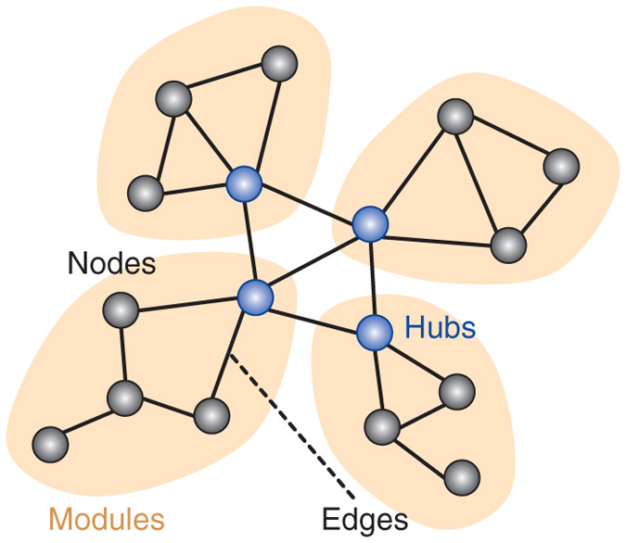
Making Sense of Brain Network Data
By Olaf Sporns
Presented by Adam Chang

Slide 2
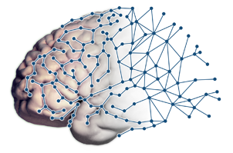
Summary
Computational models will become tools that can predict functional brain dynamics from structural data
Modularity will allow for a comparison between structural and functional networks
Current Objectives: to create models that can associate functional attributes to brain structural data

Slide 3
Opportunity
“New experimental methods for the comprehensive mapping of neural structures for large scale recording”
Large volumes of data mapping the layout of brain networks are available in public neuroinformatics databases

Slide 4
Challenge
Methodological challenges in creating accurate maps – computational models cannot create accurate enough graphs
Pitfalls in data acquisition in reconstructing connectional anatomy and dynamic neural interactions

Slide 5
Goals
Map of Functional Connectivity through imaging of millimeter-scale projections
Convert a structural map into a dynamic functional map
Create a tool of clinical benefit

Slide 6
Action
Module Detection or Modularity
Relate structural and functional
Promote robust network function
Characterize differences in networks
Identify coherent populations

Slide 7

Action
BRAIN: Brain Research through Advancing Innovative Neurotechnologies (2013)
Extend fundamental network science to the brain
Databases currently exist

Slide 8
Resolution
Connectional anatomy ➔ predicting variations in brain response and behavior
Computational models = better brain dynamics and functional attributes

Slide 9
Future
Computational models will be “guiding empirical studies of brain networks”
Simulations of brain activity in human patients (or even a virtual brain)

Slide 10
Discussion
PROS:
Structure➔Function
Understand behaviors
Clinical applications
CONS:
Structure ≠ Function
Genome project may be fundamentally different

